Slide 1
Capstone presentations
and your path from here
Can you explain what you built, what it can and cannot do, and what you will learn next?
AI and Data Science Professional | Session 24 of 24 | Module F: Ship it and present
KLAi Professional Learning | Jotham Martin Wambi
Notes:
Welcome to the last session. Over twenty-three sessions you went from a spreadsheet to a tested model, a small app and a fairness audit. Today you learn to present it. You will tell a result as an answer, evidence and limits, write an executive summary, and prepare for the questions a manager asks.
We also list plainly what this course did not cover, and you choose what to learn next.

Slide 2



Today in one view: what you will leave with
By the end of today you can
Tell a result as a story: the answer, the evidence beside a baseline model, and the limits
Write an executive summary, present to a manager and answer questions on method and risk
Name what this course did not cover and choose your next free courses and a portfolio plan
Notes:
Here is what you can do by the end of today. You can tell a result as a story with three parts: the answer, the evidence beside a baseline model, and the limits. You can write an executive summary, present to a manager and answer questions on method and risk.
And you can name what this course did not cover, and choose your next free courses and a portfolio plan. There is no code today. The lab is a rehearsal in a Google Sheet, where you plan, time and score each other.

Slide 3
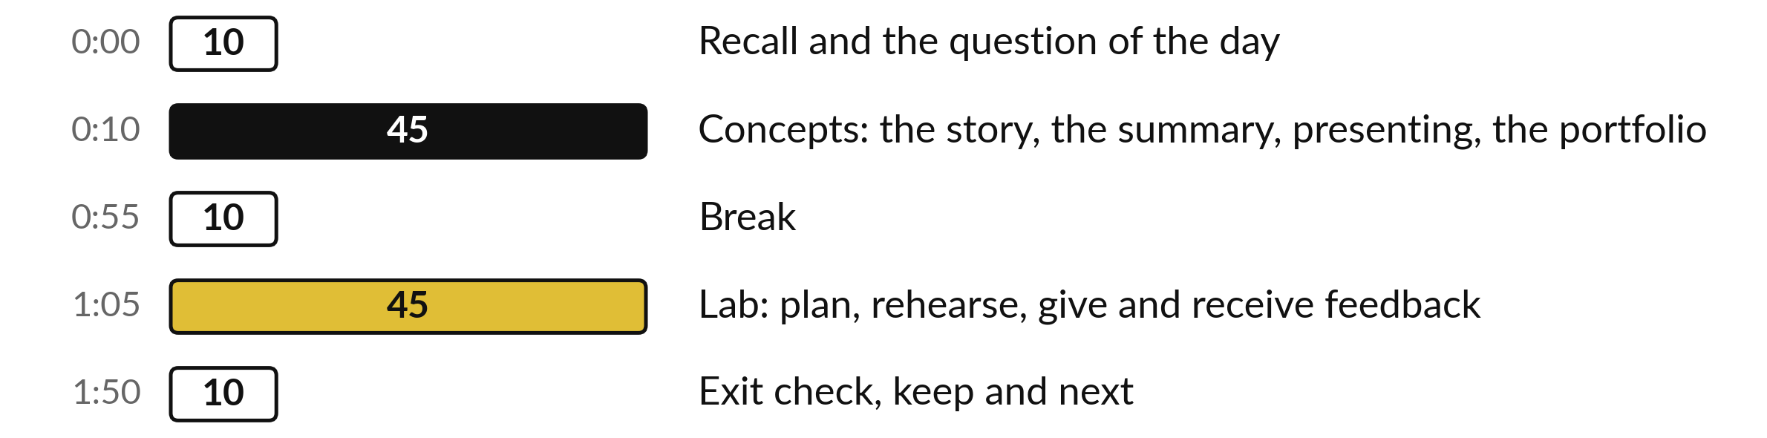
Your two hours: concepts
first, then a rehearsal lab
Ideas first. Then you plan and rehearse your talk in a sheet. Then the checks and what you keep.
Notes:
We have two hours. The first ten minutes bring back Session 23 and set the question for today. Then forty-five minutes of concepts, with no laptops open: how to tell a result as a story, how to write an executive summary, how to present to a manager, how to keep a portfolio, and what this course left out.
After a ten minute break we open a Google Sheet for a forty-five minute lab. You plan your talk, time a rehearsal, prepare answers to hard questions and score a partner. The last ten minutes are an exit check and what you keep.

Slide 4

Three questions from last time
1. What is the difference between data drift and concept drift?
2. A rule never uses gender, yet it approves 70.3% of women and 52.4% of men. What is going on, and what do you measure?
3. Name two things that never go into a public GitHub repository.
Answer aloud first. Then we check together.
Notes:
Three quick questions from Session 23. Answer aloud first, and then we check together. It is a warm-up to bring last time back.
Question one. What is the difference between data drift and concept drift?
A good answer is this. In data drift the inputs change after training. In concept drift the link between the inputs and the outcome changes.
Question two. A rule never uses gender, yet it approves 70.3% of women and 52.4% of men. What is going on, and what do you measure?
A good answer is this. A proxy variable (occupation) carries the information. Measure approval and error rates by group and the disparate impact ratio, here 0.745.
Question three. Name two things that never go into a public GitHub repository.
A good answer is this. Personal data such as names, phone numbers or loan records of real people, and passwords, keys or tokens.
If you missed one, check your notes from last session tonight. Now to today.

Slide 5



Answers to the three questions from Session 23
Question | Short answer
What is the difference between data drift and concept drift? | In data drift the inputs change after training. In concept drift the link between the inputs and the outcome changes.
A rule never uses gender, yet it approves 70.3% of women and 52.4% of men. What is going on, and what do you measure? | A proxy variable (occupation) carries the information. Measure approval and error rates by group and the disparate impact ratio, here 0.745.
Name two things that never go into a public GitHub repository. | Personal data such as names, phone numbers or loan records of real people, and passwords, keys or tokens.
Notes:
Here are the answers to the three warm-up questions. In data drift the inputs change after training. In concept drift the link between inputs and outcome changes. A rule that never uses gender but approves 70.3 percent of women and 52.4 percent of men is using a proxy variable, here occupation, and you measure approval rates, error rates and the disparate impact ratio, which was 0.745.
And personal data and passwords never go into a public repository. Today you will say all of this out loud to a manager. Which of the three would you find hardest to explain?

Slide 6





Words we use today
Word | What it means
Capstone | The larger project that ends a course. Yours is a question, data, a model with a baseline model, its limits and a talk.
Executive summary | A short opening paragraph with the answer, the evidence, the main limit and the decision you ask for. A busy reader may read only this.
Limitation | Something your result cannot tell you, such as who the data left out. You say it before you show the result.
Portfolio | A small set of your projects, for example GitHub repositories with a README, that a stranger can open and judge.
Rubric | A marking guide that lists what good work looks like for each criterion. You use it to score your partner.
Notes:
Five words for today. I give the plain meaning of each, and we use every one of them before the end of the session.
Capstone. The larger project that ends a course. Yours is a question, data, a model with a baseline model, its limits and a talk.
Executive summary. A short opening paragraph with the answer, the evidence, the main limit and the decision you ask for. A busy reader may read only this.
Limitation. Something your result cannot tell you, such as who the data left out. You say it before you show the result.
Portfolio. A small set of your projects, for example GitHub repositories with a README, that a stranger can open and judge.
Rubric. A marking guide that lists what good work looks like for each criterion. You use it to score your partner.

Slide 7
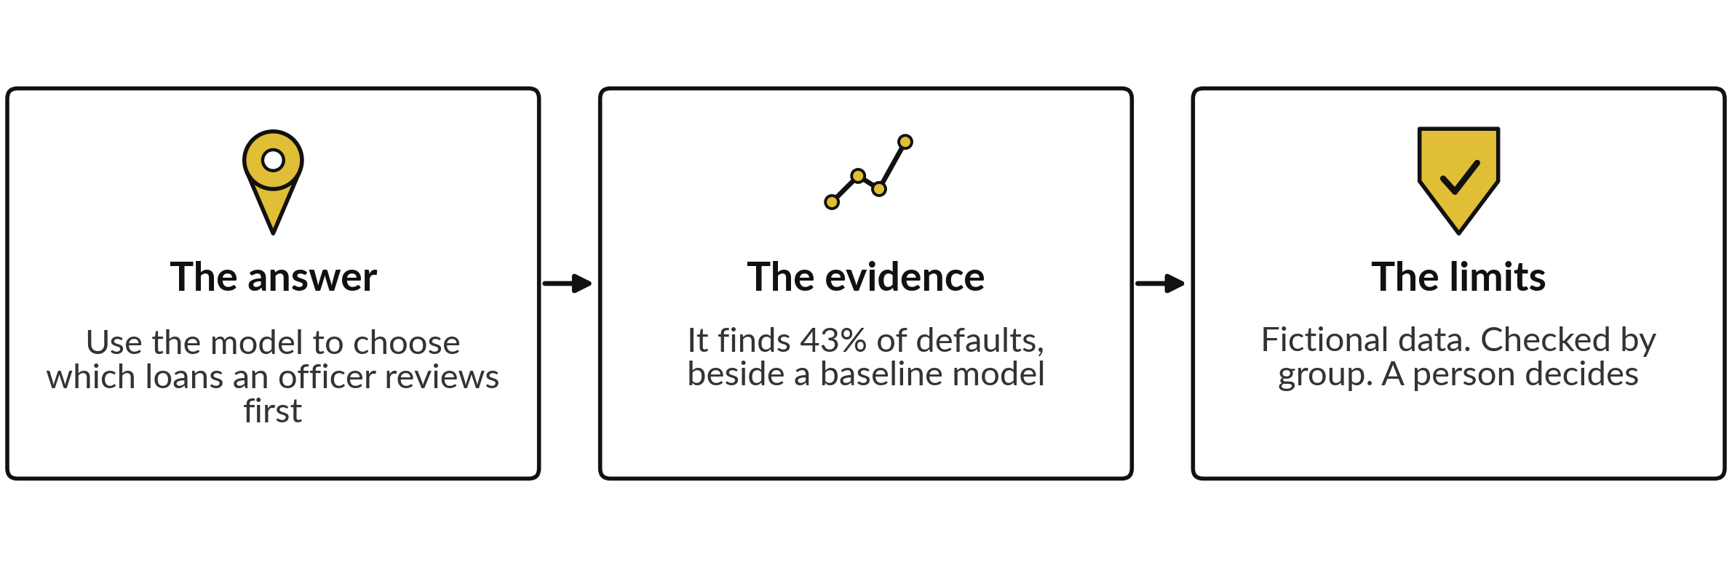
Tell a result as a story in three parts:
the answer, the evidence and the limits
The same story works for any capstone. Put the answer first, so the room knows what the evidence is for.
Notes:
Every good result tells a story in three parts. The answer comes first: what you recommend. For our loan model, use it to choose which loans an officer reviews first. The evidence comes next, and it always sits beside a baseline model. Our model finds 43 percent of defaults when it flags about 14 percent of loans.
The limits close the story: fictional data, a fairness check by group, and a person who decides. If one part is missing, the room will not know what to do with your work. What is the answer of your own capstone, in one sentence?

Slide 8





The evidence behind the loan story,
with the baseline model beside it
Measure | Number | What it means
Loans, and defaults | 8,000; 1,004 | 12.6% of loans defaulted.
Held-out test loans | 2,000; 251 defaults | Loans the model never saw.
Baseline model: always repaid | 87.5% accurate | It finds no defaults at all.
Model, decision threshold 0.5 | 89.2% accurate | Finds 51 of 251 defaults (20.3%).
Model, decision threshold 0.2 | Flags 278 loans | Finds 108 of 251 defaults (43.0%).
Area under the curve (AUC) | 0.756 | How well it ranks risky above safe: 0.5 is a coin flip.
Same loans and the same split as Sessions 14 to 17 (logistic regression, 27 columns, decision threshold 0.2). Your Session 16 numbers may differ a little if your model or decision threshold differ.
Notes:
This is the evidence we will use for practice, from the Nile Microfinance loans. There are 8,000 loans and 1,004 defaulted, which is 12.6 percent. We held out 2,000 loans, with 251 defaults. The baseline model says repaid every time. It is 87.5 percent accurate and finds no defaults.
Our model at a decision threshold of one half is 89.2 percent accurate, but finds only 51 of the 251 defaults. At a decision threshold of 0.2 it flags 278 loans and finds 108, which is 43.0 percent. The area under the curve is 0.756. These are the same loans, the same split and the same model as Sessions 15 and 16, so your Session 16 numbers may differ a little only if your model or decision threshold differ.
Which row is the story?

Slide 9
An accuracy number alone misleads:
show the baseline model beside it
The number alone
With the baseline
The model is 89.2% accurate.
It sounds strong.
Always saying repaid is 87.5% accurate.
At decision threshold 0.5 the model finds 51 of 251 defaults.
Report the baseline, the share of defaults found and the limit in one sentence.
Notes:
Here is the trap in every capstone talk. You say the model is 89.2 percent accurate, and it sounds strong. Then a careful person asks what a model that always says repaid would score. The answer is 87.5 percent, so your model is barely ahead. This is the accuracy paradox, and it happens when one answer is much more common.
At a decision threshold of one half, the model finds only 51 of 251 defaults. So give three things in one sentence: the baseline, the share of defaults found, and the limit. What would your capstone baseline be?

Slide 10
An executive summary gives the answer,
evidence, limit and request in four sentences
An executive summary is the short opening paragraph that a busy reader may read alone. Illustrative example for the loan model:
Answer
Use the model to choose which loans a loan officer reviews first.
Evidence
On 2,000 held-out loans it found 43% of defaults by flagging 14% of loans. The baseline model finds none.
Limit
The data is fictional and 379 loans lack income. We have not tested it after the data changes.
Request
Approve a three month trial where a person decides, with a fairness check by gender each month.
Notes:
This is what an executive summary looks like. Four sentences. The answer: use the model to choose which loans an officer reviews first. The evidence: on 2,000 held-out loans it found 43 percent of defaults by flagging 14 percent of loans, while the baseline model finds none. The limit: the data is fictional, 379 loans lack income, and we have not tested it after the data changes.
And the request: approve a three month trial where a person decides, with a fairness check by gender each month. A manager can decide from these four sentences alone. Write the four sentences for your capstone in the lab.

Slide 11
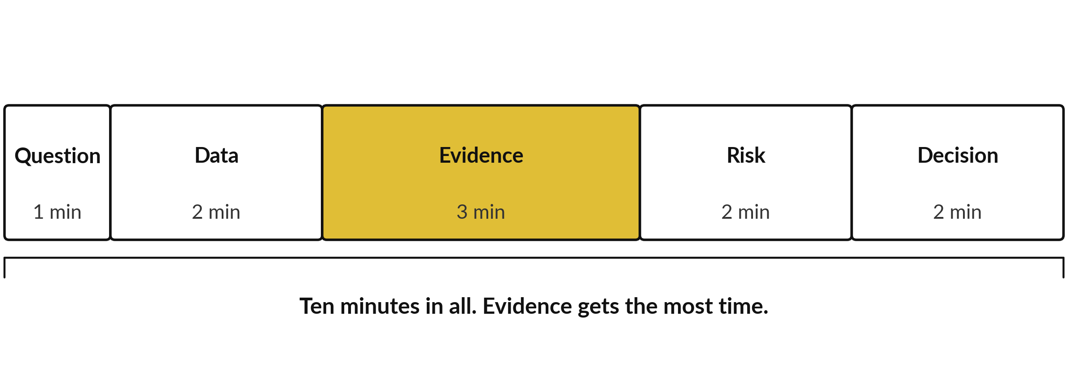
A ten-minute talk has five slides:
question, data, evidence, risk and decision
Risk: what could go wrong, and who checks. Decision: what you recommend.
Notes:
Here is the shape of your ten minute talk. Five slides. Slide one is the question: the decision someone faces, one minute. Slide two is the data: what it covers and what it leaves out, two minutes. Slide three is the evidence, the result beside its baseline, three minutes, the longest.
Slide four is the risk: what could go wrong and who checks, two minutes. Slide five is the decision: what you recommend and the next step, two minutes. Your executive summary becomes your opening sentence. Rehearse with a timer, because most people run long. Which slide will you be tempted to stretch?

Slide 12





Presenting to a manager: say the real
term, then what it means for a decision
Term | What you say next
Recall (sensitivity) | Of every 100 loans that default, how many we flag.
Precision | Of every 100 loans we flag, how many really default.
Area under the curve (AUC) | How well the model ranks risky loans above safe ones. 0.5 is a coin flip.
Baseline model | The simple rule the model has to beat.
Decision threshold | The risk level at which a loan goes to an officer.
Test set | Loans the model never saw while learning.
Start with the answer. One number per slide. Keep the notebook ready for questions.
Notes:
A manager has a few minutes and a decision to make. So start with the answer, give one number per slide, and keep the notebook ready for questions. Use the real term, because the manager may hear it again from the data team, and then say what it means.
Recall: of every hundred loans that default, how many we flag. Precision: of every hundred loans we flag, how many really default. The area under the curve is how well the model ranks risky loans above safe ones. A baseline model is the simple rule to beat. The decision threshold is the risk level at which a loan goes to an officer.
And a test set is loans the model never saw. Which term do you tend to use without explaining?

Slide 13
Say the limits before the result,
and the room trusts the result
Result first
Limits first
Opens with the best number.
Limits arrive in the last minute.
The claim lands before the caveat.
Opens with what the data covers.
Names what the model cannot do.
Then shows the result.
A limit you state loses no marks. A hidden one does.
Notes:
Two ways to open. On the left, the result comes first, with the best number. The limits squeeze into the last minute, and the room has already heard the claim, so anything you add sounds like a retreat. On the right you open with what the data covers: eight thousand fictional loans, ten districts, almost three years.
Then you name what the model cannot do. It cannot say why a borrower defaults, and it knows nothing about borrowers who were refused a loan. Then you show the result. People trust a speaker who names the limits first. Try it in your own words in the lab.
What is the biggest limit of your capstone?

Slide 14

Three questions on method,
and answers you can give
Likely question | A good answer
How do you know it works on new loans? | I kept 2,000 loans the model never saw as a test set, and compared the result with a baseline model.
Why that metric and that decision threshold? | Missing a default costs more than reviewing a good loan, so I watch recall. At decision threshold 0.2 it finds 43% of defaults, and about 39 of every 100 flagged loans really default.
Could this result be luck? | This was one split. I would repeat it with k-fold cross-validation and report the range of scores.
Notes:
Three questions about method that you should expect. How do you know it works on new loans?
Answer: I kept a test set the model never saw and compared it with a baseline model. Why that metric and that decision threshold?
Because missing a default costs more than reviewing a good loan, so I watch recall. At a decision threshold of 0.2 the model finds 43 percent of defaults, and about 39 of every hundred flagged loans really default. Could it be luck?
Honest answer: this was one split, so I would repeat it with k-fold cross-validation and report the range. An honest answer that names what is not finished is a good answer. Write your three answers in the lab.

Slide 15


Three questions on risk: drift,
fairness and data protection
Likely question | A good answer
What could go wrong once people use it? | The data could drift after training. I would compare each month of inputs with the training period, compare predicted with actual defaults, and set a review date.
Is it fair, and are we allowed to use this data? | I audited approval and error rates by gender: 86.5% of women and 85.6% of men approved. I checked the purpose and data minimisation against the Data Protection and Privacy Act, 2019 (a teaching summary, not legal advice). A person decides.
Who is responsible for it? | (Example answer for our fictional lender.) The credit manager owns the model card, and the data protection officer reviews each release.
Notes:
Three questions about risk. What could go wrong once people use it?
The data could drift after training, so I compare each month of inputs with the training period, compare predicted with actual defaults, and set a review date. Is it fair, and are we allowed to use this data?
I audited approval rates by gender, 86.5 percent for women and 85.6 percent for men, and I checked purpose and data minimisation against the Data Protection and Privacy Act of 2019. A person decides. And who is responsible?
For our fictional lender, the credit manager owns the model card, and the data protection officer reviews each release. This is a teaching summary and not legal advice. Which of these would your manager ask first?

Slide 16
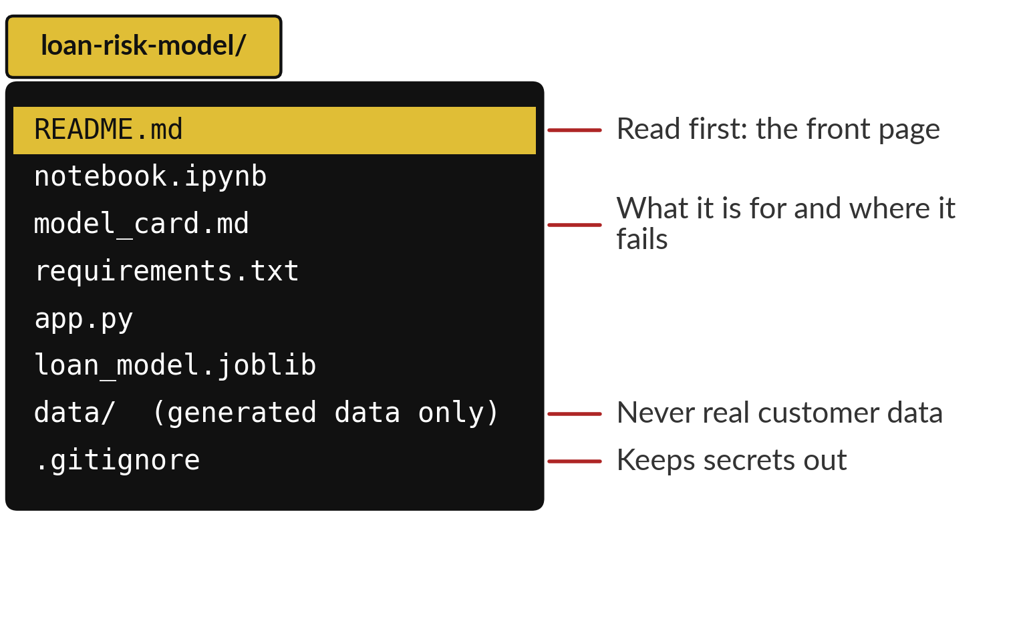
A portfolio on GitHub is a few repositories
a stranger can open in five minutes
Portfolio: a small set of your projects that others can open and judge.
Two or three projects you can explain well.
Each notebook runs from the top.
Never real customer data.
Notes:
A portfolio is a small set of your projects that a stranger can open and understand in five minutes. On GitHub that means a few repositories, each laid out like this one. The README comes first. The notebook runs from the top. The model card says what the model is for and where it fails.
The requirements file lets someone repeat your result. The app is optional. The data folder holds generated or public data only, never real customer data, and the gitignore file keeps secrets out. Choose two or three projects you can explain best. What would be the name of your first repository?

Slide 17


A README answers four questions:
what, result, limits and how to run
Section | Loan model example
The question | Which loans should an officer review first?
The result | At decision threshold 0.2 the model finds 43% of defaults on 2,000 held-out loans. The baseline model finds none.
The limits | Fictional data. Not tested after the data changes. Fairness checked by gender only.
How to run | Install requirements.txt, then Runtime, Restart session and run all.
Write it for a stranger. Say which data is generated.
Notes:
The README is the front page of your portfolio. It answers four questions. What is the question?
Which loans should an officer review first. What is the result, with its baseline?
At a decision threshold of 0.2 the model finds 43 percent of defaults on 2,000 held-out loans, and the baseline finds none. What are the limits?
Fictional data, not tested after the data changes, fairness checked by gender only. And how do you run it?
Install the requirements and run the notebook from the top. Write it for a stranger and say which data is generated. Which of the four will you find hardest to write?

Slide 18

A rubric marks four things, and you score
your partner with the same four rows
Criterion | Strong work (3) | Partly (2) | Not yet (1)
Question and evidence | A one-sentence question. Every claim points to data. | A question, but some claims lack data. | No clear question, or claims without data.
Metric and baseline | A metric chosen for the cost, on unseen data, beside a baseline model. | A metric, but no baseline. | One accuracy number, no baseline.
Limits and fairness | Limits first. Risks named. Groups compared. Data duties checked. | Some limits, said late. | Limits missing or hidden.
Clarity | Five slides, ten minutes, plain words, one decision. | Mostly clear, a little over time. | Over time, jargon, no decision.
The lab asks for one comment on each row.
Notes:
A rubric is a marking guide. Ours has four rows and you score from one to three. Question and evidence: strong work has a one sentence question and every claim points to data. Metric and baseline: a metric chosen for the cost, on unseen data, beside a baseline model.
Limits and fairness: limits first, risks named, groups compared, data duties checked. And clarity: five slides, ten minutes, plain words and one decision. A score of two means partly there. In the lab you give your partner a score and one comment on every row. Which row do you expect to score lowest yourself?

Slide 19






What this course did not cover: an honest gap list
Area | What that means for you
Mathematics by hand | You calculated results by hand but did not prove them.
Data structures and algorithms | Interview puzzles need separate practice.
Big data tools | Your data fitted in one notebook.
Paid cloud platforms | AWS, Azure, Google Cloud. You used free tiers of Colab, GitHub and Streamlit.
Deep learning from scratch | One neuron and a small network in numpy. The pretrained model was optional.
Dashboards and BI tools | Power BI and Tableau were named, not taught.
Production MLOps | No container, automated tests or monitoring.
Say these gaps yourself, before anyone asks.
Notes:
Being honest about gaps is part of being trusted. Seven things this course did not cover, as I understand the session list. Mathematics by hand: you calculated many results by hand, but you did not prove them. Data structures and algorithms: job interview puzzles need separate practice. Big data tools: your data fitted in one notebook.
Paid cloud platforms: you used Colab, GitHub and Streamlit Community Cloud, which have free tiers. Deep learning from scratch: you built a neuron and a small network in numpy, and the pretrained model was optional. Dashboards and business intelligence tools such as Power BI: we named them as hand-over tools but did not teach them.
And production machine learning operations: your app is small, with no container, automated tests or monitoring. Say these gaps yourself before anyone asks. Which gap matters most for your job?

Slide 20







Free next steps by goal: check the
current terms before you start
Goal | Free next step
Python habits | Harvard CS50P (Introduction to Programming with Python)
Everyday data work | Kaggle Learn: Pandas
Models beyond this course | Kaggle Learn: Intermediate Machine Learning
Machine learning basics again | Google Machine Learning Crash Course
Deep learning | fast.ai Practical Deep Learning for Coders
AI ideas and ethics | University of Helsinki: Elements of AI
Language models | DeepLearning.AI short courses
Cloud, big data, dashboards, MLOps | Search for a free introductory course on the tool your employer uses. Check its terms.
Free to learn, but audit, certificate and account rules change. Check each provider page.
Notes:
Here is a free next step for each goal. For Python habits, Harvard CS50P. For everyday data work, Kaggle Learn Pandas. For models beyond this course, Kaggle Learn Intermediate Machine Learning. For the basics again, the Google Machine Learning Crash Course. For deep learning, fast dot ai Practical Deep Learning for Coders.
For AI ideas and ethics, Elements of AI from the University of Helsinki. For language models, the DeepLearning dot AI short courses. For the gaps in cloud, big data, dashboards and production, I have not named a course, because I have not checked one. Search for a free introductory course on the tool your employer uses, and read its terms.
Free audit and certificate rules change, so check each provider page before you start. Which one will you start with?

Slide 21
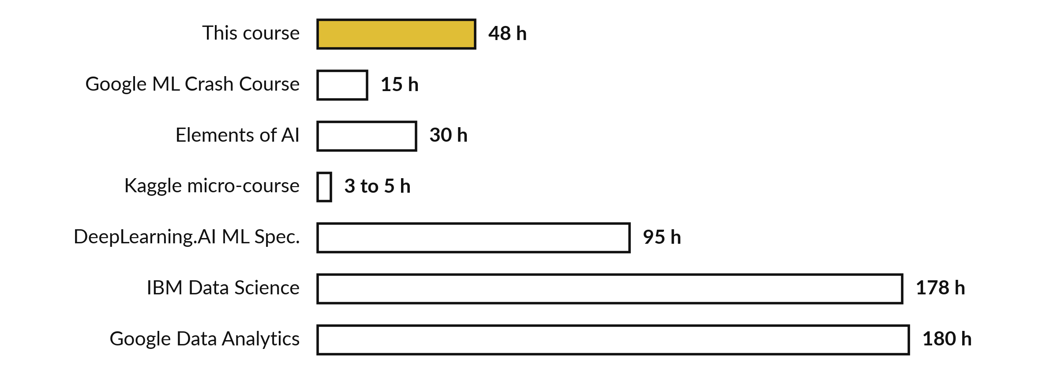
This course is 48 hours. Well-known
programmes list about 3 to 180 hours
Provider estimates at the time of writing. Some are marketing figures. They change.
Notes:
Where does this course sit?
It is forty-eight hours. Next to it are provider estimates as listed in late October 2026. They are the providers own estimates, some are marketing figures, and they change, so check each page. The Google crash course is about fifteen hours, Elements of AI about thirty, and a Kaggle Learn micro-course three to five hours.
The DeepLearning dot AI Machine Learning Specialization is about ninety-five hours, the IBM Data Science Professional Certificate about one hundred and seventy-eight, and the Google Data Analytics Certificate over one hundred and eighty. Across data certificates, one hundred and fifty to two hundred and forty hours is often quoted.
So this course gives you a base that later study extends. Which programme will you try next?

Slide 22
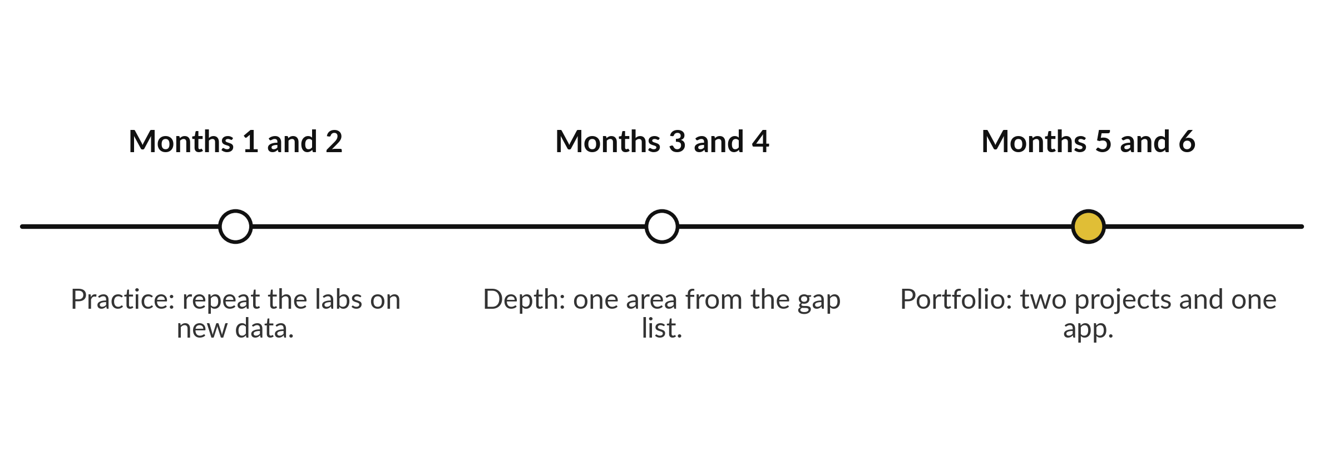
Your six month path: practice,
depth, portfolio, at 6 hours a week
6 h a week for 26 weeks is 156 h.
Notes:
Here is a six month path. Months one and two are practice: repeat the labs on new data and finish one Kaggle Learn course. Months three and four are depth: pick one area from the gap list and go further. Months five and six are the portfolio: publish two projects and one app, each with a README.
Choose a weekly budget you can keep. Six hours a week for twenty-six weeks is 156 hours, which is about the low end of the hours often quoted for a data certificate. Four hours a week is also fine, as long as you keep it. What weekly budget will you set?

Slide 23



Where you will use this at work: present
a result so a manager can decide
Your job | The presentation | What today lets you do
Credit analyst at a bank or SACCO | A monthly credit committee | Open with the answer and the baseline model, say the limits first, and show approval rates by group.
Officer in a ministry | A briefing note for a permanent secretary | Write the executive summary in four sentences, with one number and its source.
Data officer at an NGO | A donor report | State what the data covers and leaves out, and keep a portfolio of reproducible work.
Analyst at a retailer | A branch managers meeting | Explain recall and precision in plain words, with the cost of a mistake in shillings.
Notes:
Where will you use this on Monday?
Four examples. A credit analyst at a bank or SACCO presenting to the monthly credit committee should open with the answer and the baseline model, say the limits first, and show approval rates by group. An officer in a ministry writing a briefing note should write the executive summary in four sentences with one number and its source.
A data officer at an NGO writing a donor report should say what the data covers and leaves out. And an analyst at a retailer should explain recall and precision in plain words, with the cost of a mistake in shillings. Which of these meetings is closest to yours?

Slide 24
Part 2: rehearsal and feedback
Close the slides. Open the sheet.
Notes:
That is the end of the ideas. There is no code today. Open a new Google Sheet and call it Presentation plan. You will make tabs as we go: plan, rehearsal, questions, feedback and path. In every task, plan first, then do it, then check your numbers against the table on the screen.
You present to a partner, and your partner scores you with the rubric. Listening to feedback is part of the skill.

Slide 25
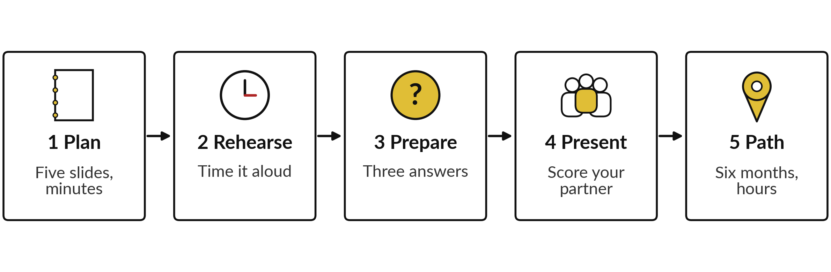
The lab has five parts, and
you keep a presentation sheet
Six tasks in 45 minutes. For each task, plan, do it, then check your numbers.
Notes:
Here is the map of the lab, in five parts. Part one, plan your five slides with minutes that add up to ten. Part two, rehearse aloud with a timer and record the time of each slide. Part three, prepare three answers: method, metric and risk. Part four, present to a partner for ten minutes and score each other on the four rubric rows, with one comment each.
Part five, write your six month path with a weekly hour budget. The numbers in the first tasks are illustrative, so you can check your formulas. Please do not skip the rehearsal. It is where talks improve.

Slide 26
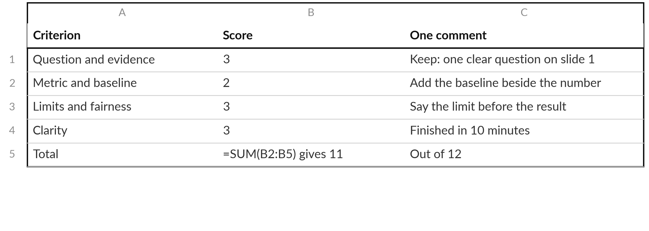
Your feedback tab: four rubric rows, a score
from 1 to 3, and one comment on each
Illustrative scores for the formula check. Your partner fills this in for your talk.
Notes:
This is the feedback tab your partner fills in. Four rows from the rubric, a score from one to three, and one comment. Each comment should point to a named slide, and at least one should say what to keep. Here the illustrative scores add up to 11 out of twelve with the SUM formula.
Notice the comments: they are specific. Keep, add, say before. A comment such as good job teaches nothing. When you receive feedback, write it down and do not defend yourself. You can ask a question to understand it. What kind of comment helps you most?

Slide 27





Check your numbers before you move on
What you compute | You should get
Planned minutes (task 1) | 1 + 2 + 3 + 2 + 2 = 10
Rehearsal total, in seconds and minutes | 710 s = 11 min 50 s
Slide that ran longest past its plan | Evidence, 60 s over
Recall at decision threshold 0.2 (task 3) | 108 / 251 = 43.0%
Precision at decision threshold 0.2 | 108 / 278 = 38.8%
Peer scores 3, 2, 3, 3: total and mean | 11 and 2.75
Learning path hours | 6 x 26 = 156
If your number differs, find the task that went wrong.
Notes:
Use this table as your checkpoint. If one number does not match, call me, because later tasks use earlier ones. The most common cause is a range that includes the header row, or typing minutes where the sheet expects seconds. Your own talk will have different numbers, and that is fine.
These check the formulas on the illustrative data. Find out why it differs. What does it mean if your rehearsal total is under nine minutes?

Slide 28

Five likely mistakes in the lab and how to fix them
What you see | What it means | What to do
In the minutes table: 11 where you expected 10 | The minutes add up to more than the plan. | Cut a sentence from the longest slide, then add the minutes again.
#VALUE! in a time formula | Text where a number is expected, such as "70 s". | Type 70 only. Put the unit in the header.
In the feedback tab: 12 where 11 was expected | The range includes the total row, or the header row. | Use B2:B5 for four scores.
Everything scored 3 | The scores are not separating strong from weak. | Find one thing to improve on each row.
A path with no named course | Without a course and a date, it stays a wish. | Name one course, a start date and the hours a week.
Notes:
Five problems you may meet. A total of eleven instead of ten means your minutes add up to more than the plan, so cut a sentence from the longest slide. A value error in a time formula usually means text in the cell, such as seventy s, so type the number only.
A sum that includes the total row or the header gives a wrong number, so check the range. If you score everything three, the scores are not helping, so find one improvement on each row. And a path with no named course is a wish. Name the course, the start date and the weekly hours.

Slide 29

Exit check: three questions, then
compare with the short answers
Question | Short answer
Which three parts make a result into a story? | The answer, the evidence beside a baseline model, and the limits.
Name two things to say before you show a result. | What the data covers and leaves out, and what the model cannot do. Name the baseline too.
Where do you confirm the terms of a free course? | On the provider page, before you start, because free audit and certificate rules change.
Notes:
Last, the exit check. Three questions. Write your answers before you look at mine. One, which three parts make a result into a story?
Two, name two things to say before you show a result. Three, where do you confirm the terms of a free course?
The short answers are on the slide. If you got all three, you are ready to present your capstone. This is the end of the course. Choose your first free course today, write the start date in your sheet, and send it to me. Thank you for twenty-four sessions of hard work.

Slide 30
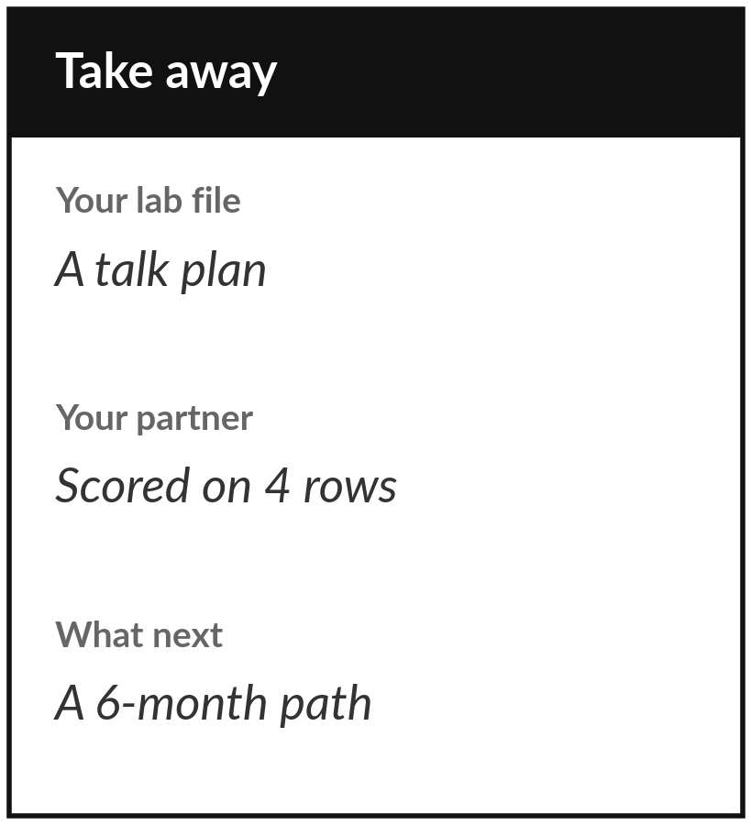
Save your sheet, and start
your six month path this week
What you keep from today
Keep your presentation sheet: the five-slide plan with minutes, your rehearsal times, three prepared answers, your partner scores and your six month learning path.
What happens next
There is no Session 25. Your six month path starts now. Tell your tutor your first free course and the day you will start.
Notes:
Before you go, save your sheet. It holds your talk plan, your rehearsal times, three answers to hard questions, your partner scores and your six month path. If a colleague could present your result from it, it is good. This is the last session, so the next step is yours: choose one free course from the list, check its current terms, and write the day you will start.
Well done for twenty-four sessions of work. Please send your tutor your capstone and your first course.

